Slide 2

GLIMPSES OF
GLORY

Slide 3
GLIMPSES OF
GLORY
The Paradise of God

Slide 4
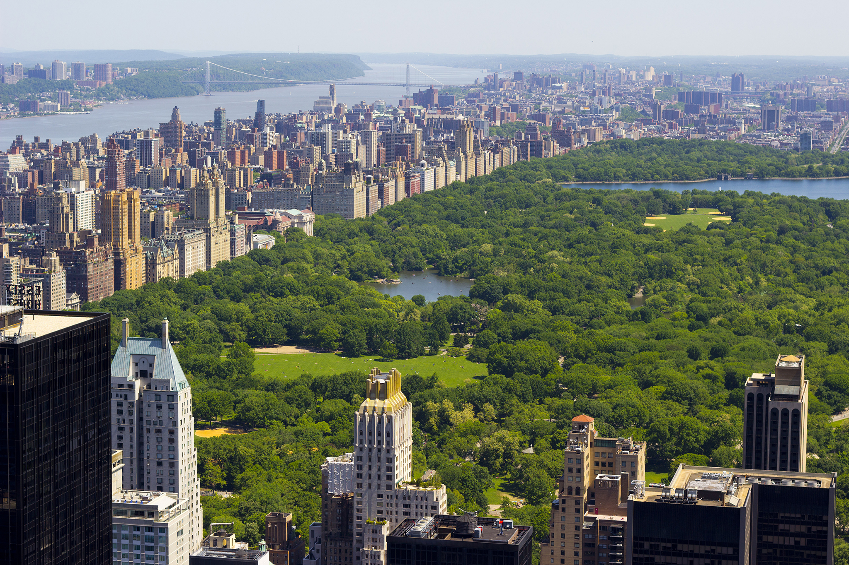

Slide 5
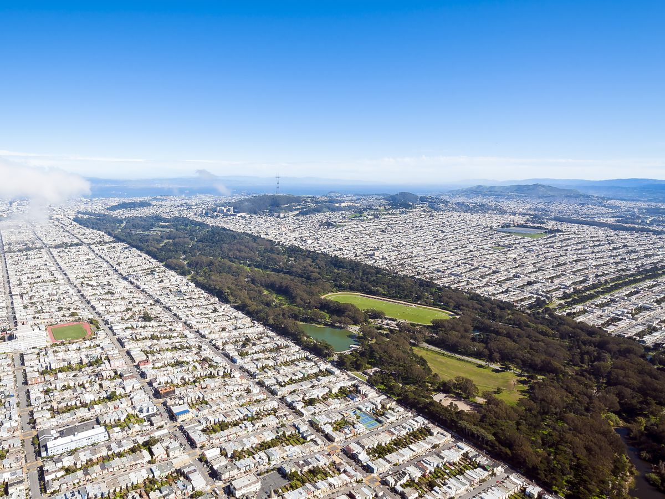

Slide 6
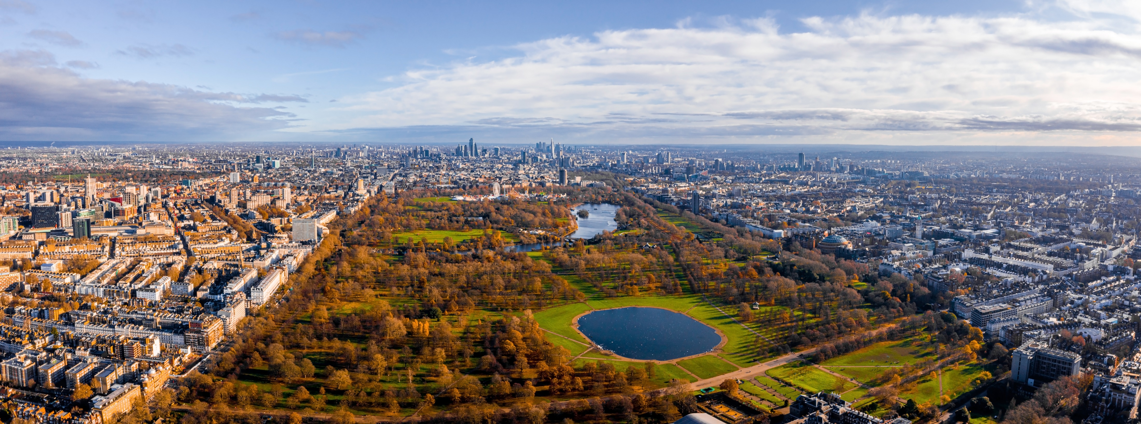

Slide 7
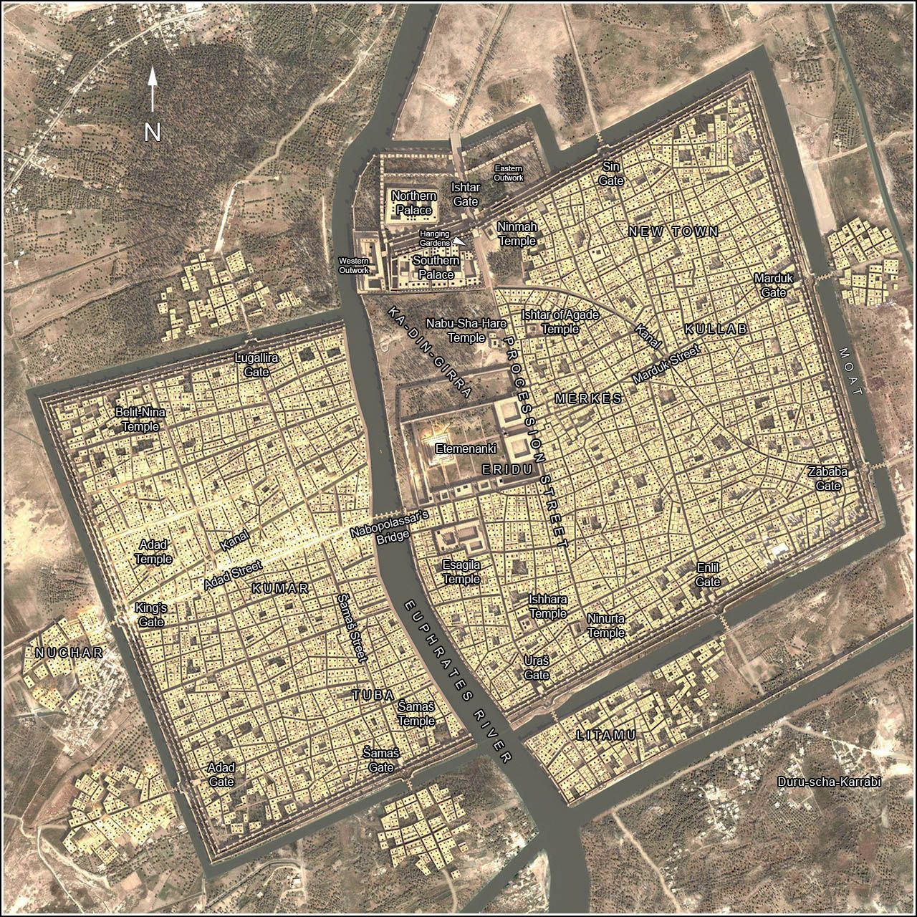
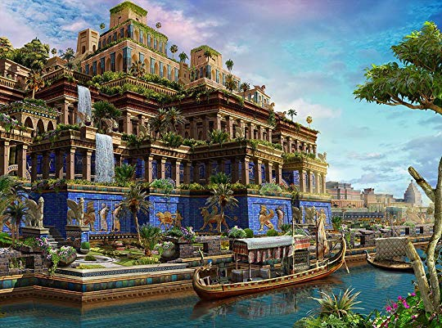


Slide 8

Paradise and the Garden of Eden
Genesis 13:10-13 “…like the garden of the Lord.”

Slide 9
Paradise and the Garden of Eden
Genesis 13:10-13 “…like the garden of the Lord.”
Revelation 2:7— “Paradise” = Persian word for “park” or “grove of trees” (like the Garden of Eden).

Slide 10
Paradise and the Garden of Eden
Genesis 13:10-13 “…like the garden of the Lord.”
Revelation 2:7— “Paradise” = Persian word for “park” or “grove of trees” (like the Garden of Eden).
Revelation 21:1-6, 22-27; 22:1-5

Slide 11
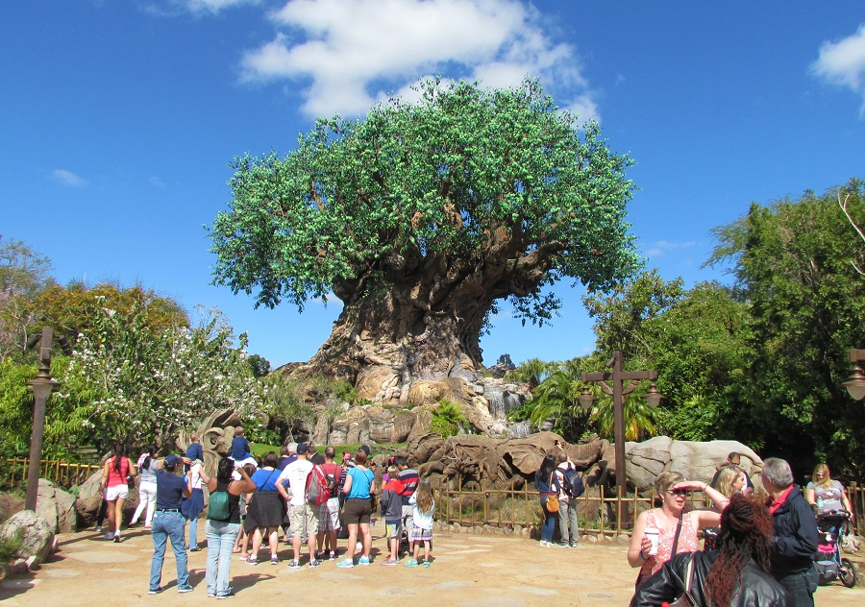

Slide 12
Paradise and the Garden of Eden
Genesis 13:10-13 “…like the garden of the Lord.”
Revelation 2:7— “Paradise” = Persian word for “park” or “grove of trees” (like the Garden of Eden).
Revelation 21:1-6, 22-27; 22:1-5
Heaven is identified in Revelation as “paradise” (2:7) and here we find it complete with a tree of life (22:2) and a river of life (22:1) where God “tabernacles” or dwells with His people (21:3).

Slide 13
What Does the Image of “Paradise” Imply?
Paradise Implies Life
  Revelation 21:4; 22:1-2

Slide 14
What Does the Image of “Paradise” Imply?
Paradise Implies Life
  Revelation 21:4; 22:1-2
  John 9; John 10:7-10 “…that they may have life, and that they may have it more abundantly.”

Slide 15
What Does the Image of “Paradise” Imply?
Paradise Implies Life
Paradise Implies Fellowship
  Revelation 22:22

Slide 16
What Does the Image of “Paradise” Imply?
Paradise Implies Life
Paradise Implies Fellowship
  Revelation 22:22
  Revelation 21:3

Slide 17
What Does the Image of “Paradise” Imply?
Paradise Implies Life
Paradise Implies Fellowship
  Revelation 22:22
  Revelation 21:3
  John 9; John 10:7-10 “…that they may have life, and that they may have it more abundantly.”

Slide 18
What Does the Image of “Paradise” Imply?
Paradise Implies Life
Paradise Implies Fellowship
  Revelation 22:22
  Revelation 21:3
  John 9; John 10:7-10 “…that they may have life, and that they may have it more abundantly.”
  The Joy of Heaven is found in “dwelling” with God.

Slide 19
What Does the Image of “Paradise” Imply?
Paradise Implies Life
Paradise Implies Fellowship
  Revelation 22:22
  Revelation 21:3
  John 9; John 10:7-10 “…that they may have life, and that they may have it more abundantly.”
  The Joy of Heaven is found in “dwelling” with God.
  John 14:1-3

Slide 20
What Does the Image of “Paradise” Imply?
Paradise Implies Life
Paradise Implies Fellowship
Paradise Implies Healing, Rest, and Escape from Hardship
  Revelation 22:2b-5

Slide 21
What Does the Image of “Paradise” Imply?
Paradise Implies Life
Paradise Implies Fellowship
Paradise Implies Healing, Rest, and Escape from Hardship
  Revelation 22:2b-5
  Genesis 3:16-19

Slide 22
What Does the Image of “Paradise” Imply?
Paradise Implies Life
Paradise Implies Fellowship
Paradise Implies Healing, Rest, and Escape from Hardship
  Revelation 22:2b-5
  Genesis 3:16-19
  The curses are replaced with blessings.

Slide 23
What Does the Image of “Paradise” Imply?
Paradise Implies Life
Paradise Implies Fellowship
Paradise Implies Healing, Rest, and Escape from Hardship
  Revelation 22:2b-5
  Genesis 3:16-19
  The curses are replaced with blessings.
  Revelation 21:4

Slide 24
GLIMPSES OF
GLORY
The Holy City
The Bride of Christ
The Paradise of God

Slide 25
V1, 6—Don’t You Want to Go to That Land
Don’t you wanna go to that Land? (3x)
Where I’m bound, where I’m bound.
Don’t you wanna go to that Land? (3x)
Where I’m bound, where I’m bound.
V2—Nothing but LOVE in that Land…
V3—Nothing but JOY in that Land…
V4—Nothing but PEACE in that Land…
V5—‘Cause I’ve got a savior in that Land…

